Slide 1
PROCESS AND CPU SCHEDULING, PROCESS COORDINATION

Slide 2
What is process?
A process is a program in execution which then forms the basis of all computation.
The process is not as same as program code but a lot more than it.
A process is an 'active' entity as opposed to the program which is considered to be a 'passive' entity.
Attributes held by the process include hardware state, memory, CPU, etc.
Process memory is divided into four sections for efficient working :

Slide 3
The Text section is made up of the compiled program code, read in from non-volatile storage when the program is launched.(executable code)
The Data section is made up of the global and static variables, allocated and initialized prior to executing the main. (Global variables)
The Heap is used for the dynamic memory allocation and is managed via calls to new, delete, malloc, free, etc.
The Stack is used for local variables. Space on the stack is reserved for local variables when they are declared. (Temporary data storage when invoking the functions)

Slide 4
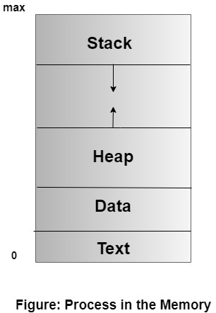

Slide 5
Process State
As a process executes, it changes state. The state of a process is defined in part by the current activity of that process. A process may be in one of the following states:
New: The process is being created.
Running: Instructions are being executed.
Waiting: The process is waiting for some event to occur (such as an I/O completion or reception of a signal).
Ready: The process is waiting to be assigned to a processor.
Terminated: The process has finished execution.

Slide 6
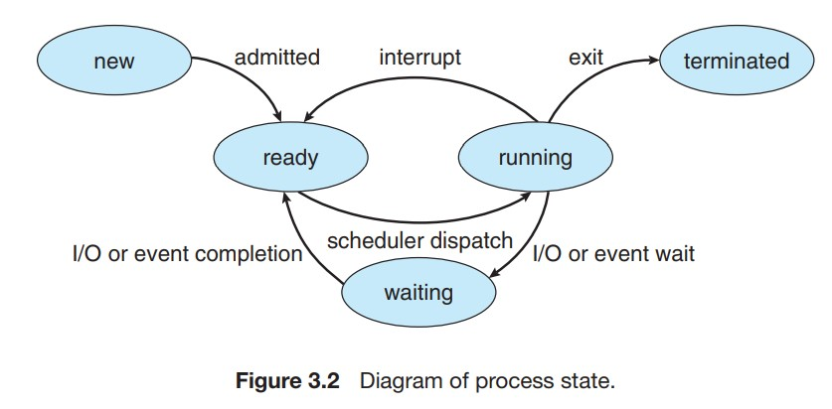

Slide 7
Process Control Block
The Process Control Block (PCB) in an operating system is a data structure that stores essential information about an individual process or task.
It is also known as the Task Control Block (TCB) or Control Block in some operating systems.
The PCB is a fundamental concept in process management and plays a crucial role in enabling multitasking and coordinating the execution of multiple processes in a system.
Each process in an operating system is represented by its unique PCB. When a process is created, the operating system allocates memory for its PCB, populates it with relevant information, and keeps it in the system’s process table.
The PCB remains associated with the process throughout its lifetime, even if the process is temporarily suspended or preempted.

Slide 8
Role of Process Control Block
The PCB contains various pieces of information related to the process, including:
Process State: The current state of the process, such as running, ready, waiting, or terminated. The operating system uses this information to schedule and manage the execution of processes effectively.
Process Identifier (PID): A unique numeric identifier assigned to each process, allowing the operating system to distinguish between different processes.
Program Counter (PC): A pointer to the address of the next instruction to be executed in the process. When the process is suspended and later resumed, the PC helps to continue execution from the last point.

Slide 9
CPU Registers: The contents of the CPU registers, including general-purpose registers and special-purpose registers. The operating system saves these registers in the PCB during a context switch to facilitate process switching.
Memory Management Information: Details about the memory allocated to the process, including base and limit registers or page tables, which help in memory protection and addressing.
Priority: The priority of the process, which determines its importance and influences the process scheduling algorithm.

Slide 10
Parent and Child Process Relationship: Information about the parent process (creator) and any child processes created by this process.
File Descriptors: A list of open files associated with the process, allowing the process to access files and perform I/O operations.
Accounting Information: Statistics and accounting data, such as CPU time used, time of process creation, and resource usage, for monitoring and resource management purposes.

Slide 11
Threads
Thread is an execution unit that consists of its own program counter, a stack, and a set of registers where the program counter mainly keeps track of which instruction to execute next, a set of registers mainly hold its current working variables, and a stack mainly contains the history of execution.
Threads are also termed as lightweight processes as they share common resources.
Threads are a popular way to improve the performance of an application.
Threads are mainly used to represent a software approach in order to improve the performance of an operating system just by reducing the overhead thread that is mainly equivalent to a classical process.

Slide 12
Components of Thread
A thread has the following three components:
Program Counter
Thread ID
Set of registers
Stack

Slide 13
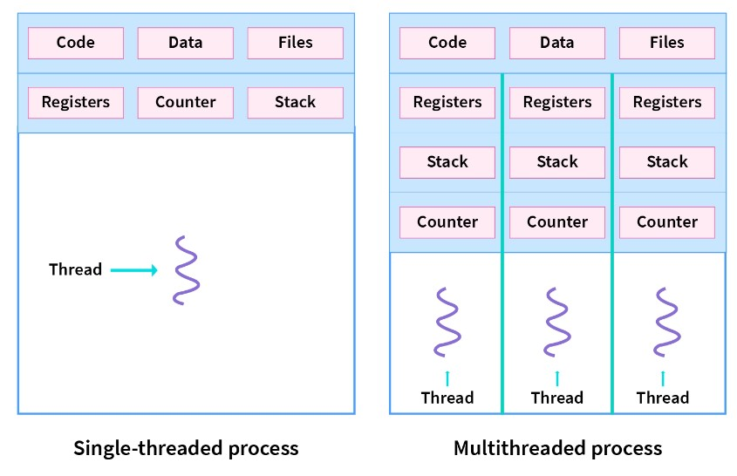

Slide 14
Types of threads
1. User Level Thread:
User-level threads are implemented and managed by the user and the kernel is not aware of it.
User-level threads are implemented using user-level libraries and the OS does not recognize these threads.
User-level thread is faster to create and manage compared to kernel-level thread.
Context switching in user-level threads is faster.
If one user-level thread performs a blocking operation then the entire process gets blocked. Eg: POSIX threads, Java threads, etc.

Slide 15
2. Kernel level Thread:
Kernel level threads are implemented and managed by the OS.
Kernel level threads are implemented using system calls and Kernel level threads are recognized by the OS.
Kernel-level threads are slower to create and manage compared to user-level threads.
Context switching in a kernel-level thread is slower.
Even if one kernel-level thread performs a blocking operation, it does not affect other threads. Eg: Window Solaris.

Slide 16
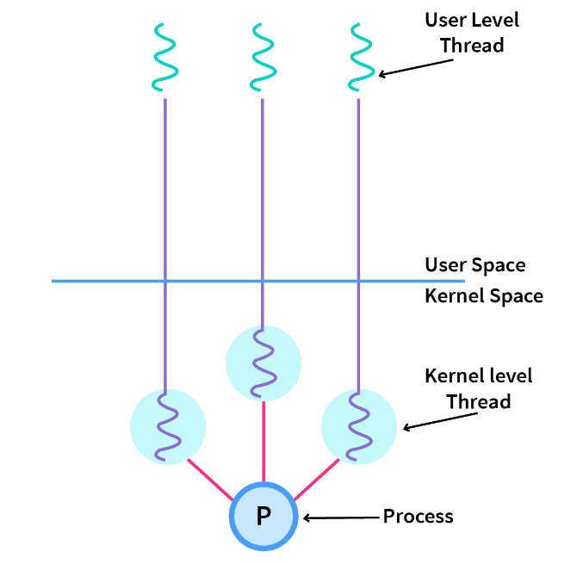

Slide 17
Difference between Process and Thread
Process simply means any program in execution
Processes use more resources and hence they are termed as heavyweight processes.
Creation and termination times of processes are slower.
Processes have their own code and data/file.
Communication between processes is slower.
Context Switching in processes is slower.
Processes are independent of each other.
Eg: Opening two different browsers.
Thread is a segment of a process
Threads share resources and hence they are termed as lightweight processes.
Creation and termination times of threads are faster compared to processes.
Processes have their own code and data/file.
Communication between threads id faster
Context Switching in processes is slower.
Threads, on the other hand, are interdependent. (i.e they can read, write or change another thread’s data)
Eg: Opening two tabs in the same browser.

